Slide 1

Group 3 Syed Alam Giai Tran Thuy Nguyen Y Nguyen
COSC 3337 Data Science I
Nour Smaoui and Christoph F. Eick

Slide 2

Contraceptive Method Choice Data Set
This dataset is a subset of the 1987 National Indonesia Contraceptive Prevalence Survey. The samples are married women who were either not pregnant or do not know if they were at the time of interview. It contains 1473 person data in a single file.

Slide 3

Preprocessing Data
Dataset Summary
Number of Instances: 1473
Number of Attributes: 9 (excluding the class label)
Number of class lables: 3
1= No-use
2= Long-term
3= Short-term
Missing attributes values: none
Attribute Characteristics: Categorical, Integer.

Slide 4
Preprocessing Data
Techniques & Tools
Scikit Learn
MinMaxScaler, Normalizer, StandardScaler – scaling data
Kfold – k fold crossing validation
Confusion Matrix, Classification Report – visualize testing resul
MLPClassifier – Neural Network
K Neighbors Classifier – KNN
Random Forest Classifier – Random Forest
SVC – Support Vector Machine
Grid SearchCV – training data with a list of parameters for optimization
Imbalance Learn SMOTE – deal with oversampling
Others: Pandas, Numpy, Seaborn, Matplot Library.
Programming Language: Python
Cloud Service: Google Colab.

Slide 5
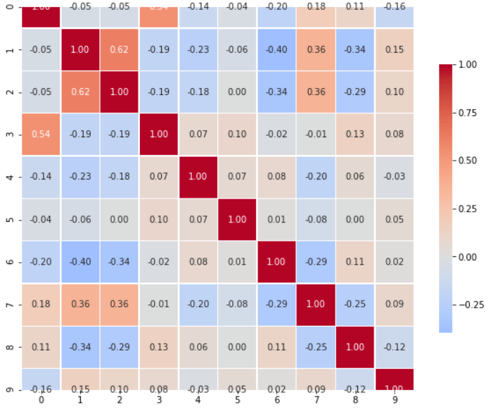
Preprocessing Data
Correlation Checking
We need to check the correlation of features by plotting the correlation matrix.
Conclusion:
From the correlation matrix above, it shows clearly that there is not any pair features which are highly correlated together. So, we can keep all features.

Slide 6
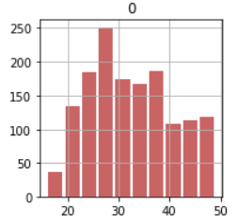
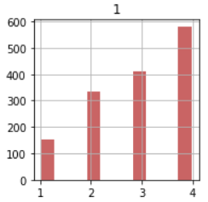
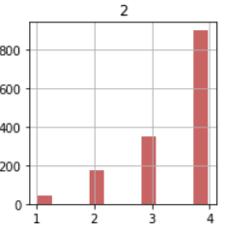
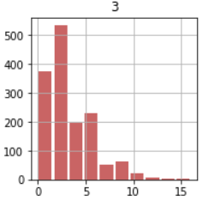
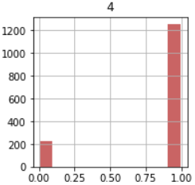
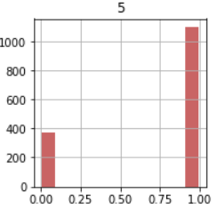
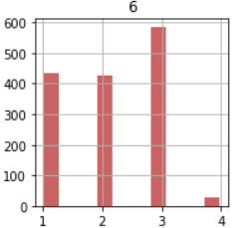
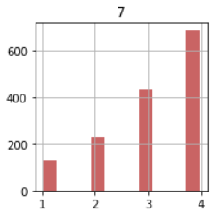
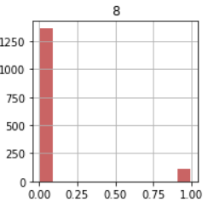
Histogram Plots for Feature’s Distributions
Next, we would like to see how the feature's distribution in the followed figures.

Slide 7
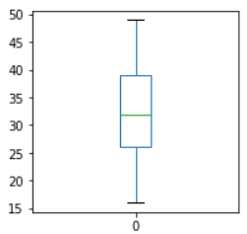
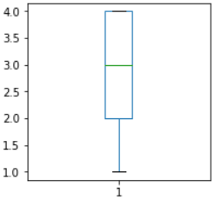
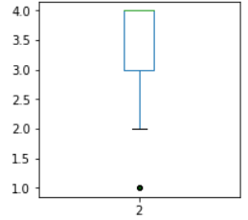
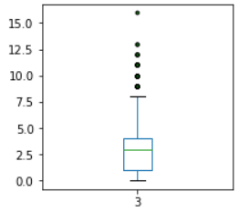
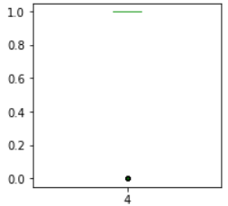
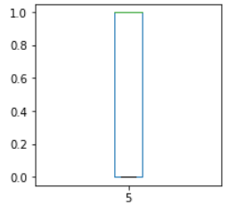
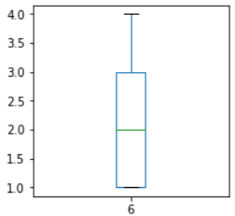
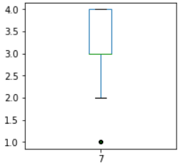
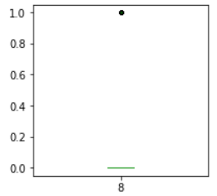
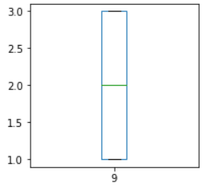
Outliner Removal
We need to go to check the outlier of data before use. Because the noise of data can affect deeply to the final performance of model. We plot the outlier of each feature in the figures as follows.

Slide 8
Outliner Removal
Observe from the outlier figures, we firstly check if we should drop the feature number 4, 5, or 8.

Slide 9
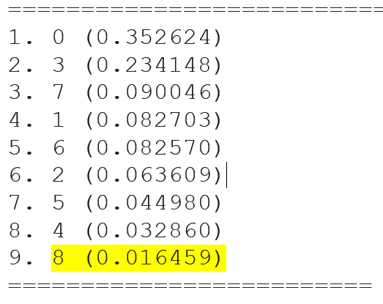
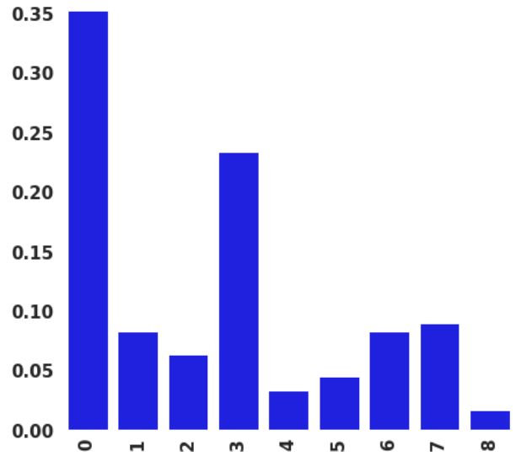
Feature Ranking
We would like to experiment further by using Random forest classfier to evaluate the importance of each feature.
Conclusion:
Based on the ranking of features and the outliner boxplot. We decide to drop feature 8 because feature 8 does not help in explaining the class labels.

Slide 10
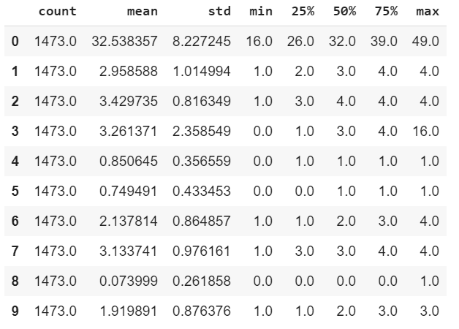
Handling the normalization
Based on the descriptive information from the statistic table, we can see the difference in range of values in each features, especially for the first feature. So, we might need the normalization for this data.

Slide 11
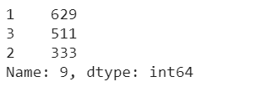
Check balancing of dataset
An imbalanced dataset could result in a low accuracy in applying classification method.
Solution: applying oversampling/ undersampling
Oversampling : you duplicate the instance of the minority class(class 2) to obtain a balanced dataset. Undersampling : you drop instance of the majority class(class 1 or 3) to obtain a balanced dataset, see illustration.
We decide to use oversampling (SMOTE algorithm).
SMOTE: Synthetic Minority Over-sampling Technique. It creates synthetic (not duplicate) samples of the minority class and apllies KNN approach where it selects K nearest neigbors, joins them and creates the synthetic samples in the space.

Slide 12
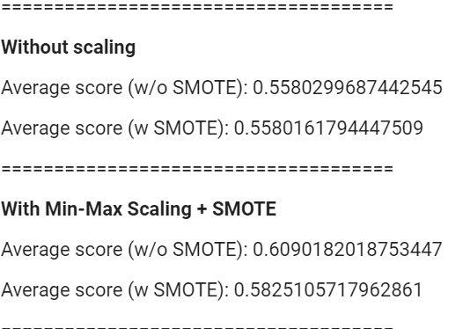
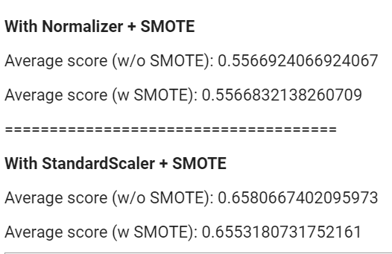
Neural Network
Experiment Results
We conclude that the accuracy is higher by using StandardScaler comparing to the others. We are going to use the dataset + StandardScaler + from now on.

Slide 13
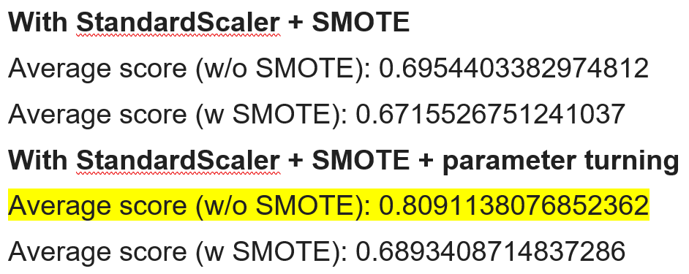
Neural Network
Experiment Results
Conclusion: the highest test score is trained with StandardScaler + parameter tuning without SMOTE.

Slide 14
SVM – Support Vector Machine
SVM with default parameter
SVM with Applied Cross Validation
SVM with applied Cross Validation and SMOTE
Average score : 0.555994
Average score: 0.547150
Based on the accuracy scores above, our support vector classification with Applied Cross Validation with out SMOTE has a higher accuracy score than SVC with SMOTE.
We are using default value, in order to improve our accuracy score, apply parameter tuning may help to improve the accuracy.
(Parameter tuning is the process to selecting the values for a model’s parameters that maximize the accuracy of the model.)

Slide 15
SVM – Support Vector Machine
In order to determine the optimal values for given model, we conduct the grid search using scikit-learn’s GridSearchCV(Grid Search Cross Validation)
Create Parameter Candidates
Before looking for which combination of parameter values produces the most accurate model, we must specify the different candidate values we want to try.
C : 0.1, 1, 10, 100, 1000
gamma: 0.0001,0.001,0.05,0.01,0.5,1
kernels: linear, RBF
The grid search will try all combinations of parameter values and select the set of parameters which provides the most accurate model for each fold
Grid search is the process of performing hyper parameter tuning in order to determine the optimal values for a given model. This is significant as the performance of the entire model is based on the hyper parameter values specified.

Slide 16
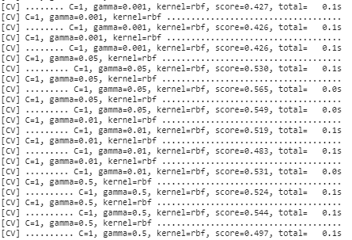
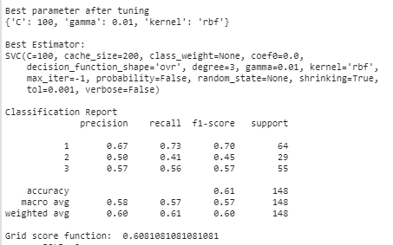
Example from first fold of GridSerachCV:

Slide 17
SVM – Support Vector Machine
All possible parameter sets produce the highest accuracy score among 10 folds
{'C': 10, 'gamma': 0.01, 'kernel': 'rbf'} | Average score (w/o SMOTE): 0.555994 Average score (w SMOTE): 0.543092
{'C': 100, 'gamma': 0.01, 'kernel': 'rbf'} | Average score (w/o SMOTE): 0.555994 Average score (w SMOTE): 0.547830
{'C': 1000, 'gamma': 0.001, 'kernel': 'rbf'} | Average score (w/o SMOTE): 0.555994 Average score (w SMOTE): 0.554642
{'C': 1, 'gamma': 0.05, 'kernel': 'rbf'} | Average score (w/o SMOTE): 0.570247 Average score (w SMOTE): 0.551236
{'C': 10, 'gamma': 0.05, 'kernel': 'rbf'} | Average score (w/o SMOTE): 0.562792 Average score (w SMOTE): 0.547817

Slide 18
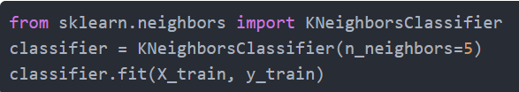
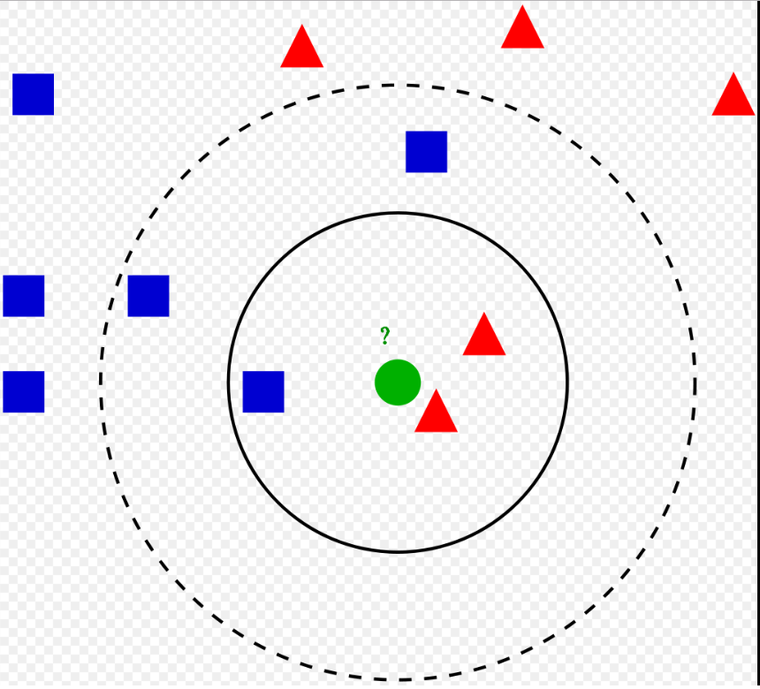
KNN – K Neighbors Nearest
import the KNeighborsClassifier class from the sklearn library.
Use: Feature Scaling, SMOTE
Choose value for the K:
There is no ideal value for K, however 5 seems to be the most commonly used value for KNN algorithm.
Data scientists usually choose as an
odd number for K
Test with value K = 5, K= 7 and K = 11.

Slide 19
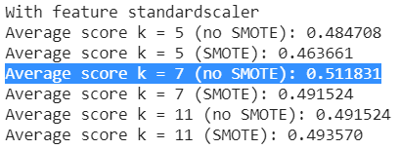


KNN – K Neighbors Nearest
The results are around 0.5.
That means our KNN algorithm was able to classify all the 147 records in the test set with 50% accuracy, which is not high, but not bad as well.
K = 7, without SMOTE won with precision of 0.512
Accury 51.2%
easy to implement
KNN is a simple yet powerful classification algorithm.
It requires no training for making predictions
This makes the KNN algorithm much faster than other algorithms that require training
The KNN algorithm has a high prediction cost for large datasets

Slide 20



Random Forest Classifier
Configuration

Slide 21
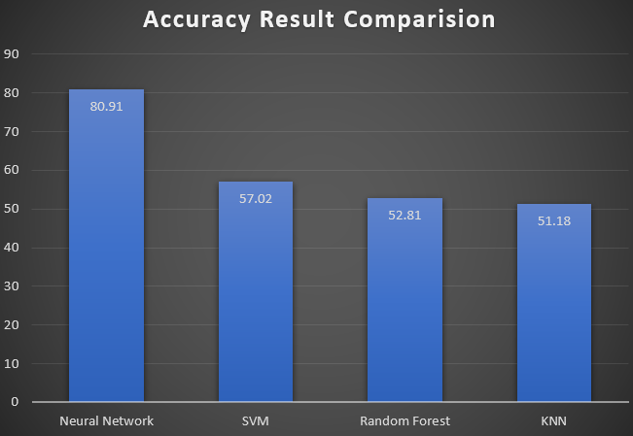
Final Report

Slide 22

Other Possible Approaches
Combining features
Ensemble Learning
The goal of ensemble methods is to combine the predictions of several base estimators built with a given learning algorithm in order to improve generalizability / robustness over a single estimator.
Example: Adaboost.

Slide 23
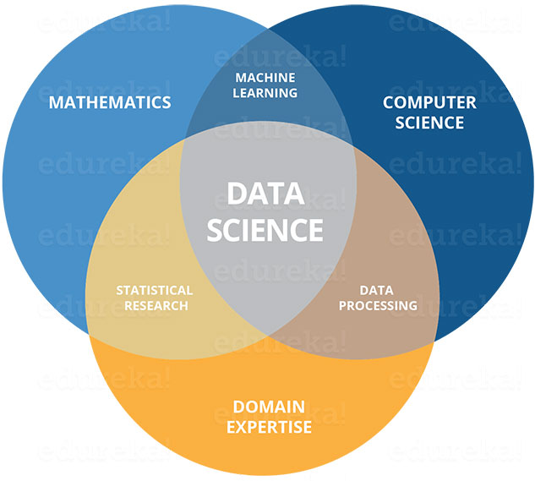
Thank You

